Slide 1


Slide 2
IN-PIT CRUSHING AND CONVEYING IN SURFACE MINES

Slide 3
INTRODUCTION
In hard rock surface mines, the mining system adopted is generally a discontinuous/cyclic one. Such a system broadly consists of the following unit operations vis-à-vis the equipment to accomplish them.
Ground preparation:
Ground preparation for subsequent excavation and/or loading is generally accomplished with the help of drilling and blasting. Drilling may be done by percussive / rotary / rotary-percussive blasthole drills depending on site specifics and requirements.

Slide 4
Excavation and/or loading:
The blasted material (ore and/or waste) is excavated and/or loaded by cyclic excavators. Electric rope shovels or hydraulic shovels are most commonly used for this purpose. Draglines may be used for handling overburden (fully or partly) in surface coal mines mining horizontal or flat (dip upto 1 in 20) seams.
Hydraulic backhoe is used where digging below the crawler level is required, and front-end-loader may also be used as primary excavator to handle ore and/or waste under some special situations.

Slide 5
Transportation:
Shovel (electric/hydraulic), backhoe and front-end-loader - all loads the excavated material into the dumper for subsequent transportation either to the ore stock pile/plant area or to the waste-dump (external or internal or both). Dragline transports its own load to the adjacent de-coaled area following the method of strip mining.
Dumping:
In case of both the dumper and dragline, dumping is done by the equipment itself.
Levelling:
Levelling, in all most all the cases, is done by dozer.

Slide 6
Of the above unit operations, either the drilling & blasting or the transportation is the most costly one. With the increase in depth of working, generally the unit cost of drilling & blasting remains unchanged, whereas, the unit cost of transportation by dumper for both the ore and waste increases, and the rate of increase in unit transport cost also increases with the increase in depth. As a result of this, generally in shallower mines the drilling & blasting operation may be most costly one, but in deeper mines the transportation becomes the costliest unit operation. So it is necessary to minimize the unit transport cost for better economy of operation particularly in case of deeper mines.

Slide 7
During 1940s, particularly after the Second World War, the dumper transport system because very popular in hard rock mines. The dumpers were preferred over rail-road transport system because of its flexibility and the ability to negotiate a higher gradient (1 in 16) compared to that negotiated by rail road system ( 1 in 33). However, during 1960s the fuel prices started rising steadily, and as a result of which the dumper transportation cost also started rising very steeply.
In the early part of 1960s, attempts were made to control/reduce the unit transport cost by increasing the truck size thereby taking the advantage of scale of operation. The main focus was to reduce the manpower and with it the personnel cost associated. But later on the attention of the mine planners and operators were drawn to the application of conveyor as an alternative means of transportation due to the fact that substantial savings of cost is possible by changing to conveyor transport from truck haulage system.

Slide 8
CONVEYOR TRANSPORT VS TRUCK HAULAGE
In a comparison of dump trucks with belt conveyor for mine transport, the following may be observed.
The trucks consume 60% of available mechanical energy to carry their dead weight; only 40% energy is used to carry the payload. But for belt conveyors, 10% to 20% energy is required to carry the belt while carrying the material in plane or uphill direction and rest 80% to 90% energy is utilized to carry the material, Conveyors carrying material down hill may generate energy.
Dump trucks need good haul road for their efficient operation. So good compact haul roads must be built and maintained. For conveyors such requirement is not there or very less.

Slide 9
The dump trucks can negotiate maximum gradient upto 1 in 16 for long hauls whereas the conveyors can run effectively upto a gradient of 1 in 4.
Productivity of dump trucks rapidly goes down with the increase in length of transport distance and of the lifting height due to increase in cycle time. The effects of increase in transport distance and of the lifting height on the productivity in case of conveyor transport system is very nominal.
The energy cost to transport same payload over same distance or for lifting same vertical height is more in case of dumper than in case of conveyor.
To transport 100 te of payload over a distance of 5 kms, the dump truck will need about 40 lit.of diesel (≈ Rs.1000/-), whereas the belt conveyor will use about 60 Kwh (≈ Rs.180/-).
To hoist 100 te of payload by 50m, the dump truck will need about 10 lit of diesel (≈ Rs.250/-), whereas the belt conveyor will use about 15 Kwh (≈ Rs.45/-).

Slide 10
A brief account of merits and demerits of belt conveyor systems over truck haulage system is given below:
Merits:
Lower capital expenditure due to a longer depreciation period
Lower energy costs and superior energy efficiency
Less manpower required
Lower maintenance cost
Can negotiate higher gradients (upto 1 in 4)
Can handle high output (upto 4000 te/hour)
Less sensitive to weather conditions
Less adverse effects on environment (less dust, noise, etc.)
High availability
Possibility of automation

Slide 11
Demerits:
Less flexibility
High initial investment costs
Require size material for efficient operation
Less suitable for big size lumps or un-sized material
In the event of stoppage of any one of the belts, the whole belt network has to be stopped
Trucks are capable of handling almost any size of lump that may be loaded by an excavator/loader onto it, but this is not so in case of a conveyor. The maximum lump size that can be transported on conveyors depends on belt width, speed, troughing angle and conveyor inclination. The design of a conveyor will also be dependent on the frequency of large lumps to be carried.

Slide 12
As a rule of thumb, the maximum lump size should be less than 350 mm for belts of 1000 mm or more width, less than 300mm for belts of 800 mm width and less than 200 mm for belt width of 650mm.
Therefore, in hard rock mines, to utilize belt conveyors as the means of transportation of materials (ore and/or overburden/waste) out of pit to the preparation plant or to the waste dumps, the material needs to be sized before being loaded onto a conveyor. This calls for installation of in-pit crushing systems.

Slide 13
IN-PIT CRUSHING SYSTEMS
In response to the increasing truck haulage costs and in the face of increasing tonnage to be moved, two large U.S. copper mines responded in late 1960s and early 1970s by installing high capacity belt conveyor systems with large, permanent type, gyratory in-pit crushers. The systems did not eliminate the trucks all together, but restricted their use only within the pit from the working faces to the crusher, and the crushed material thereafter was transported to the plant (ore) and waste dumps (waste) through belt conveyors.

Slide 14
Duval Corporation began installation of the first movable in-pit crushing and conveying systems in 1981 at its Sierrita Copper and Molybdenum Minenear Tucson, Arizona, and the operation of the system began in 1982 December. Operation of another similar system also began in 1982 at Sishen’s North Iron Ore Mine in South Africa. Since then, in-pit crushing and conveying systems has been adopted in many surface mines, both coal and non-coal, throughout the world.
In India, in-pit crushing and conveying systems have been installed in surface coal mines at Piparwar Opencast Project (CCL), Ramagundam-II Opencast Mine (SCCL) and Padmapur Opencast Project (WCL), and in Limestone mine at Jhinkpani (ACC).

Slide 15
General Applicability of In-pit Crushing and Conveying Systems:
In-pit crushing and conveying systems may be used to transport ore (i.e., pay mineral) to the processing plant and/or overburden (waste) to the waste dumps from the pit.
In most of the cases, the pay mineral (which normally requires primary crushing in its preparation process) can be transported by belt conveyors at lower cost than by trucks. But for overburden conveying, the necessary preparation and dumping costs are a considerable extra that requires to be offset by savings in trucking and truck haulage costs. In general, only when large quantities of overburden are to be transported over fairly long distances at considerable lifting heights, application of crusher-conveyor-stacker system may be justified.

Slide 16
Types of In-pit Crushing System
The various in-pit crushing systems may be classified broadly into three categories – Stationary/Permanent in-pit crushing system, Relocatable/Movable in-pit crushing system and Mobile in-pit crushing system.
Stationary/Permanent In-pit Crushing System:
In this type of systems, large capacity crushers (separate crusher for ore and for waste) with proper foundation are installed in permanent locations at or near the pit floor level. The material, excavated and/or loaded by shovel, from all the working faces (of same type, i.e. ore or waste) are transported to the respective crusher by trucks, and thereafter the crushed material is transported to respective location (ore plant or waste dump) by stationary conveyors.

Slide 17
The crushers are usually positioned so as not to create any inconvenience in the future extension of mine working and to ensure that uphill movement of loaded trucks carrying material from the working faces to the crusher is minimized. However, with the advancement of mine workings, the truck transport distance increases with time as the faces moves away from the crusher location.
This system is most suitable in case of surface mines mining flat ore bodies so that –
In course of operations the pit floor depth remains essentially same,
Large quantities of ore to be transported over a long distance that may or may not be associated with considerable vertical lift.
The benches on one side of the pit (or at least a part of it) have reached their ultimate position and became stationary.

Slide 18
Following components form the chain of handling devices for stationary/permanent in-pit crushing and conveying system.
Sl. No. | Activity | Equipment
1. | Crushing | Stationary crusher unit
2. | Transportation of ore to plant | Stationary conveyors
3. | Transportation of waste to waste dumps | Stationary conveyors Shiftable dump face conveyors Tipper car Spreader

Slide 19
A schematic presentation of stationary in-pit crushing and conveying system is given below.
T
W
F
-
1
W
S
T
W
F
-
2
To Waste Dump
W
S
Stationary Waste Conveyor
T
W
F
-
3
WASTE ROCK
T
W
S
CRUSHER
W
F
-
n
W
S
WF
–
Waste Face WS
–
Waste Shovel
OF
–
Ore Face OS
–
Ore Shovel
T
–
Material transported by truck
T
O
F
-
1
OS
T
O
F
-
2
To Ore Plant
OS
Stationary Ore Conveyor
T
O
F
-
3
ORE
T
OS
CRUSHER
O
F
-
n
OS

Slide 20
Relocatable/Movable In-pit Crushing System:
In such systems, the crushers used are of medium capacity, and they that do not require extensive foundation work as required by stationary in-pit crushers. In a mine, depending on the mine specifics (the number of working faces and their relative location, material types to be handled total tonnage of ore and of waste to be handled), there can be one or more such crushers installed.
Generally, each crusher serves a group of working faces excavating same type of material (ore or waste), and the crusher is placed at a location such that the overall truck haulage distance from the working faces it serves is optimized. The crusher, following the advance of working faces it serves, is relocated/moved to the new load center at appropriate time intervals.

Slide 21
In this system, also, the material excavated and/or loaded by shovel is transported by trucks from the face to the crusher. The haulage distance is kept as short as practicable and, if possible, uphill haulage is either avoided or restricted to a minimum. The crusher discharges onto relocatable conveyor (that is relocated or lengthened in conjunction with the relocation of the crusher) which in turn transfers the material to the stationary conveyor. This system is suitable for a mine where –
The production is medium to large
The working faces are distributed in number of benches
A stationary in-pit crushing system is not suitable.

Slide 22
Following components form the chain of handling devices for relocatable/movable in-pit crushing and conveying system.
Sl. No. | Activity | Equipment
1. | Crushing | Relocatable crusher unit Moving device
2. | Transportation of ore to plant | Relocatable conveyors Stationery conveyors
3. | Transportation of waste to waste dumps | Relocatable conveyors Stationery conveyors Shiftable dump face conveyors Tripper car Spreader

Slide 23
A relocatable in-pit crushing system has been installed at Ramagundam-II Opencast Mine of SCCL. Altogether 3 numbers of double roll type crushers for overburden and one double roll type crusher for coal have been installed. After crushing, the coal is conveyed to CHP via coal conveyors and overburden is transported to overburden dumps via overburden conveyor. In the dump area, the material is transferred to shiftable dump face conveyor for subsequent dumping via tripper car and spreader. There are 3 numbers of tripper car and 3 numbers of spreader for dumping the overburden suitably at the dumpsites.

Slide 24
A schematic presentation of relocatable in-pit crushing and conveying system is given below.
T
WS
WF
-
11
T
WF
-
1
2
T
WS
RC
WC 1
WF
-
1
n
WS
T
WS
WF
-
2
1
To Waste Dump
RC
T
WF
-
2
2
Stationary
Waste Conveyor
T
WS
WC
2
WF
-
2
n
WS
RC
T
WF
-
m
1
T
WS
m
WS
WF
-
2
WF
–
Waste Face OF
–
Ore
Face
WC
m
T
WF
-
m
n
WS
–
Waste Shovel OS
–
Ore Shovel
WS
WC
–
Waste Crusher OC
–
Ore Crusher
RC
–
Relocatable and/or extendable conveyor
T
O
F
-
11
T
–
Material transported by truck
T
O
S
O
S
O
F
-
1
2
O
C 1
T
n
RC
O
S
O
F
-
1
T
O
S
O
F
-
2
1
To
Ore Plant
RC
T
O
F
-
2
2
Stationary
Ore
Conveyor
T
O
S
O
C
2
O
F
-
2
n
O
S
RC
T
O
F
-
m
1
T
O
S
m
O
S
O
F
-
2
m
T
m
n
O
C
O
S
O
F
-

Slide 25
Mobile In-pit Crushing Systems:
In such a system, the crusher is fully mobile and is located at vary near the face. The crusher is fed directly by an excavator (Rope shovel or hydraulic shovel or front-end-loader). The crusher discharges either directly or via a beltwagon (or conveyor bridge in some cases) onto the shiftable face conveyor. Finally the material is conveyed to the respective destination (ore plant for one and waste dumps for waste) through a network of belt conveyors. The crushers are generally of small capacity sufficient to handle the production from the face where it is located.
This system is applicable for mines where only a few fast moving working faces exist and the excavators stay permanently at the same face.

Slide 26
Following components form the chain of handling devices for mobile in-pit crushing and conveying system.
Sl. No. | Activity | Equipment
1. | Crushing | Mobile crusher unit
2. | Transportation of ore to plant | Transfer unit-belt wagon, mobile conveyor bridge Shiftable conveyor with mobile hopper Stationary conveyors
3. | Transportation of waste to waste dumps | Transfer unit-belt wagon, mobile conveyor bridge Shiftable conveyors with mobile hopper Stationary conveyors Shiftable dump face conveyors Tripper Car Overburden Spreader

Slide 27
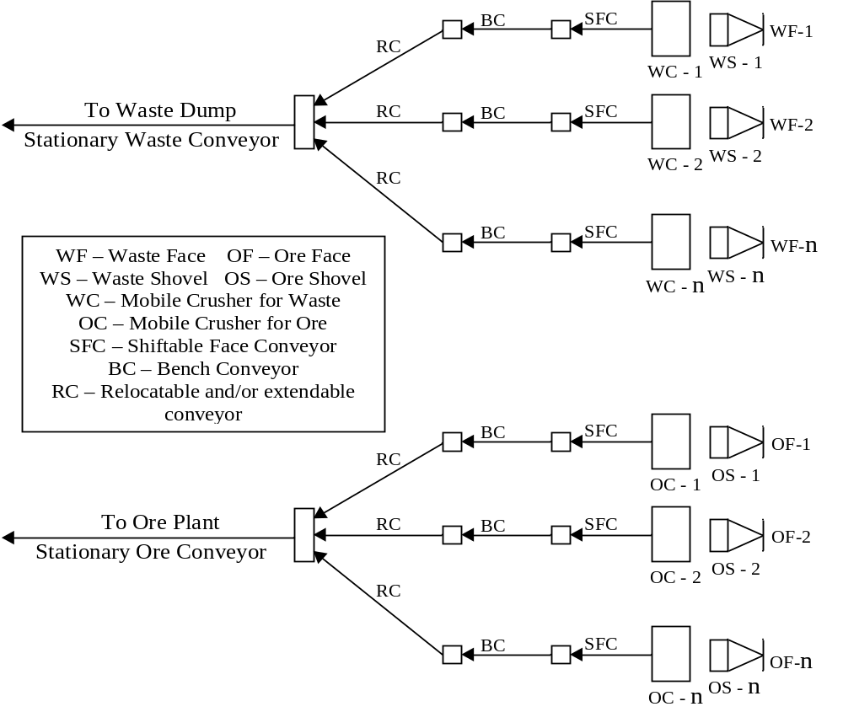
A schematic presentation of mobile in-pit crushing and conveying system is given below.

Slide 28
A mobile in-pit crushing system is in operation at Piparwar Opencast Project of CCL. The in-pit crushing is done only for coal excavated at the working face of lowermost coal seam (Lower Dakra), and the crushed coal is transported directly to the coal washery located near by the mine via a system of belt conveyors. The components for the system are 25m³ rope shovel, 2800 TPH mobile roll crusher unit, belt wagon, shiftable face belt conveyor and other conveyors (shiftable and stationary).

Slide 29
Applicability of Various Crusher Types
 Most Suitable
 Suitable
 Not Suitable
Material conditions Crusher Type | Compressive Strength |  |  | Crushing Ratio |  |  |  | Abrasivity |  |  | Moisture
 | Soft | Medium | Hard | 1:5 | 1:15 | 1:30 | 1:50 | Low | Medium | High | Dry | Moist | Wet
Single-Toggle Jaw crusher |  |  |  |  |  |  |  |  |  |  |  |  | 
Double – Toggle Jaw crusher |  |  |  |  |  |  |  |  |  |  |  |  | 
Cone Crusher |  |  |  |  |  |  |  |  |  |  |  |  | 
Roll Crusher |  |  |  |  |  |  |  |  |  |  |  |  | 
Single shaft Hammer crusher |  |  |  |  |  |  |  |  |  |  |  |  | 
Single shaft Hammer crusher with grate |  |  |  |  |  |  |  |  |  |  |  |  | 
Double shaft Hammer crusher |  |  |  |  |  |  |  |  |  |  |  |  | 
Double shaft Hammer crusher with grate |  |  |  |  |  |  |  |  |  |  |  |  | 
Single shaft Impact crusher |  |  |  |  |  |  |  |  |  |  |  |  | 
Single shaft Impact crusher with grate |  |  |  |  |  |  |  |  |  |  |  |  | 
Double shaft Impact crusher |  |  |  |  |  |  |  |  |  |  |  |  | 
Double shaft Impact crusher with grate |  |  |  |  |  |  |  |  |  |  |  |  | 

Slide 30
THANK YOU

